Slide 1
Detection and Analysis of
Polycystic Ovary Syndrome
Data Science Boot Camp
Final Presentation
Ethan Bootehsaz, Kaiyuan Ma, Joy Wang
04/30/2024
Notes:
Project Judging Criteria
Projects will be judged on the following criteria and prizes will be awarded to the top performing projects:
Using 1 (lowest)-3 (highest)
Project Design: How was the project designed and did students ask questions that helped move the project forward proactively?
1: Project not designed well; yields no tangible results or applicability
2: Project designed to move forward, but disjointed approach
3: Project designed to move forward in systematic way
Addressing Stated Problem: How well does the project solve the stated problem?
1: Results did not address stated problem at all
2: Results include missing details and inconclusive results
3: Results solves stated problem at face value
Presentation and Demo: How was the presentation?
1: Project presentation lacked any sort of depth and clarity, student(s) presenting did not clearly address issues from prompt
2: Project presentation included little detail and inconclusive results, difficult to understand
3: Project presentation addresses challenges stated in prompt clearly and concisely, easy for audience to follow and understand

Slide 2
Agenda
Goal
Data Preprocessing Steps
Exploration of Data
More Dataset Features
Initial Hypothesis
Model Selection
Logistic Regression
Deep Learning
Deep learning with Cross Validation
Results & Discussion
Model Performance
Future Improvements

Slide 3
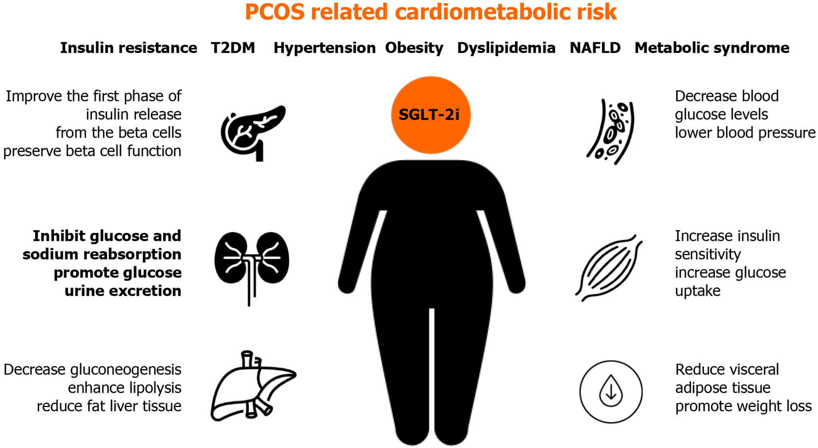
What is PCOS?
PCOS affects 7–10% of women of and is the most common cause of infertility. In the United States, an estimated 5 to 6 million women have PCOS.
Condition where ovaries produce an excessive amount of male hormones (androgens)
May or may not develop cysts due to problems in menstrual cycle (anovulation)

Slide 4
Goal
Our goal was to develop a predictive model for the detection of Polycystic ovary syndrome (PCOS) by utilizing relevant physical and clinical parameters.
We analyzed the dataset to identify patterns and trends.
We developed a model that can predict the likelihood of PCOS.
We evaluated the model's performance using various metrics.
We created visualizations to support our findings.

Slide 5
Data Preprocessing Steps
Initial Data Cleaning
Removed irrelevant columns: Unnamed: 44, Sl. No, and Patient File No. to focus on analytically useful data.
Renamed mislabeled columns to ensure consistency: Changed Marraige Status (Yrs) to Marriage Status (Yrs).
Data Formatting
Standardized column names by stripping leading/trailing whitespaces.
Cleaned data entries to remove trailing commas and periods for accuracy in analysis.
Handling Data Quality Issues
Identified and removed rows where data had non-numeric characters in numeric fields to maintain data integrity.
Dataset Post-Processing
Final dataset comprised of 539 rows ready for further analysis and modeling.
Notes:
drop(['Unnamed: 44', 'Sl. No', 'Patient File No.']
rename(columns={'Marraige Status (Yrs)': 'Marriage Status (Yrs)'}
columns.str.strip()
Remove leading/trailing whitespaces from the data, remove trailing commas, periods
1 Data had a character instead of number values so it was removed entirely
Final data had 540 rows

Slide 6
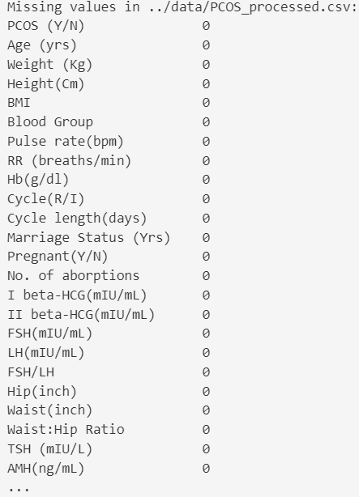
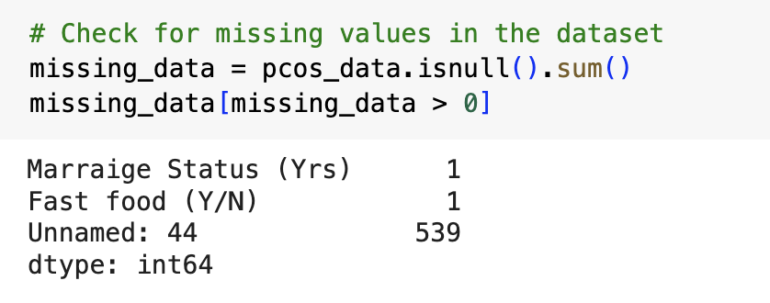
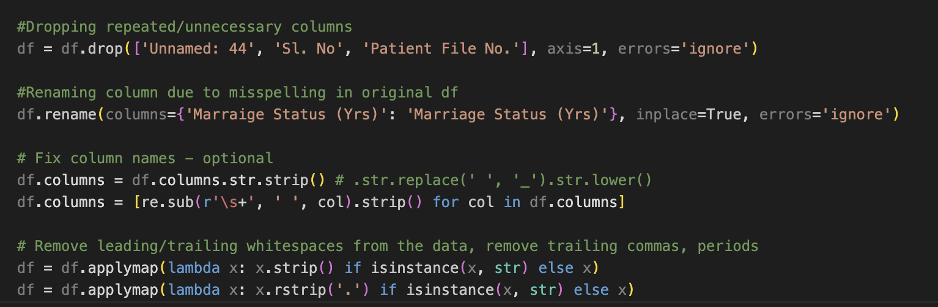

Slide 7
Exploration of Data
Understanding Correlation Calculation in Data Analysis
df.corr()['PCOS (Y/N)']
Correlation coefficients range from -1 to 1. A coefficient close to 1 indicates a strong positive correlation, meaning as one variable increases, so does the other. A coefficient close to -1 indicates a strong negative correlation, where one variable increases as the other decreases. A coefficient near 0 suggests no linear relationship.
Notes:
We calculated the correlation coefficients between the variable 'PCOS (Y/N)' and all other numeric variables in the dataset. This statistical method is used to identify the strength and direction of linear relationships between 'PCOS (Y/N)' and these variables."
As well show, our dataset shows several columns with high correlation coefficients with the target variable, this suggests that these variables have a strong linear relationship with the target. This became particularly useful when deciding on the type of model we wanted to employ for predictive purposes.

Slide 8
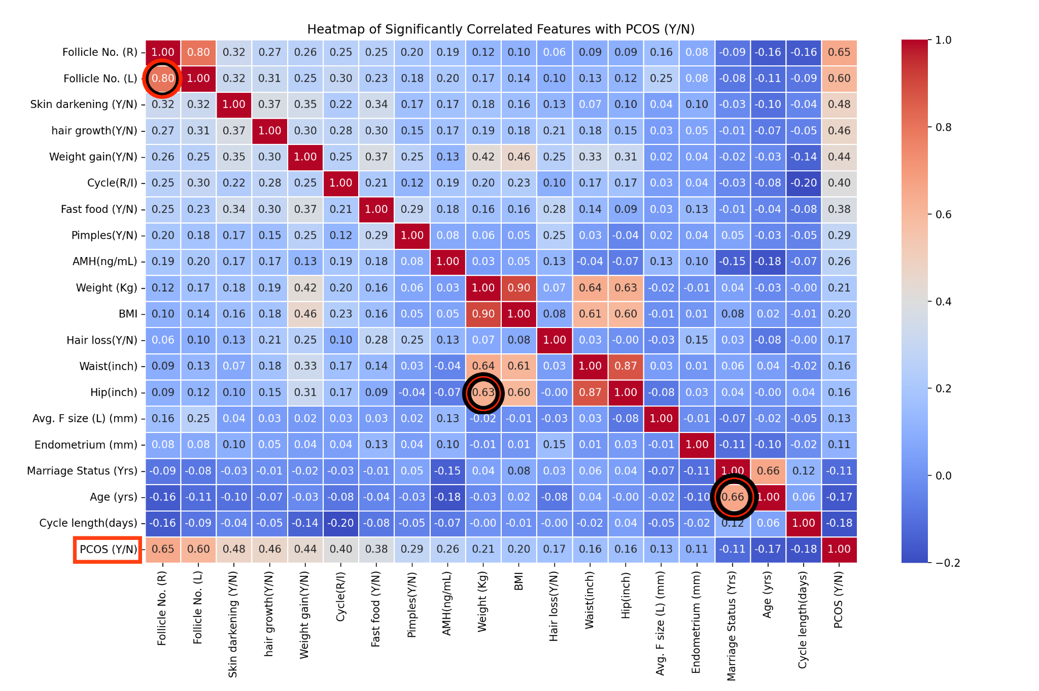
Notes:
This heatmap represents the significant correlations found across various features in our dataset. It helps us identify strong relationships and potential areas of interest for deeper analysis, providing insights that can guide further research and data-driven decision-making.
Before we focus on the PCOS column, there were some interesting correlations worth noting:
Follicle Count Correlations: "High correlations between 'Follicle No. (L)' and 'Follicle No. (R)' at 0.799 demonstrate a consistent pattern in follicle counts between the left and right ovaries, indicating a symmetric biological response in ovarian activity."
Anthropometric Measures: "'Weight (Kg)' shows a strong positive correlation with 'BMI' at 0.902, reflecting expected associations due to the calculation basis of BMI. Similarly, 'Hip (inch)' and 'Waist (inch)' are highly correlated at 0.874, pointing to a significant link between body weight distribution measures."
Marriage Status: "There is a significant positive correlation between age and marriage status at 0.661579. This strong correlation indicates that as age increases, so does the likelihood or duration of being married, reflecting typical societal patterns."
Now to focus on the PCOS columns

Slide 9
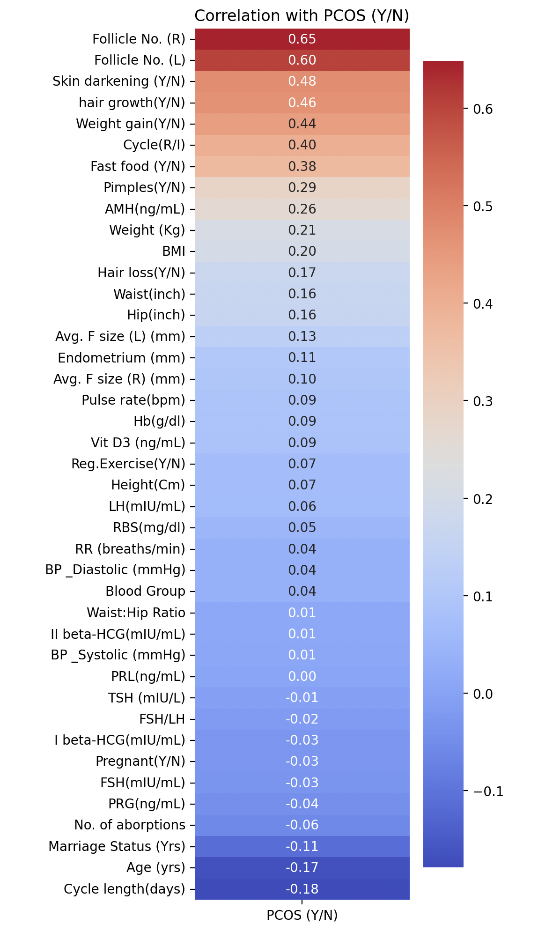
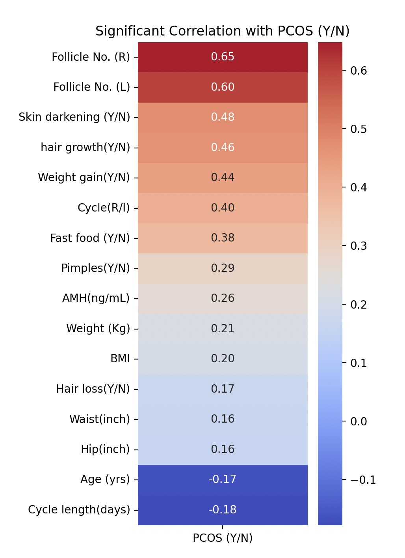
Notes:
By focusing only on the target correlations, it avoids clutter and potential confusion that might arise from a larger, more complex correlation matrix heatmap.
Follicle Numbers: "We observe the highest correlations with PCOS occurrence in relation to 'Follicle No. (R)' at about 0.648 and 'Follicle No. (L)' at about 0.603. This suggests a strong association between the number of follicles on the right and left ovaries and the presence of PCOS, indicating their potential as predictive biomarkers for PCOS."
Lifestyle Factors: "Noticeable lifestyle-related factors include 'Skin darkening (Y/N)', 'hair growth (Y/N)', and 'Weight gain (Y/N)', with correlations of 0.475, 0.464, and 0.440 respectively. These factors are commonly associated symptoms and consequences of PCOS, reflecting hormonal imbalances and metabolic issues."
A negative correlation means there is an inverse relationship between two variables.
Age and PCOS (Y/N): A negative correlation of -0.167422 suggests that as age increases, the likelihood or prevalence of PCOS decreases. This might reflect that PCOS symptoms or diagnoses are more common in younger women and tend to decrease or stabilize with age.

Slide 10
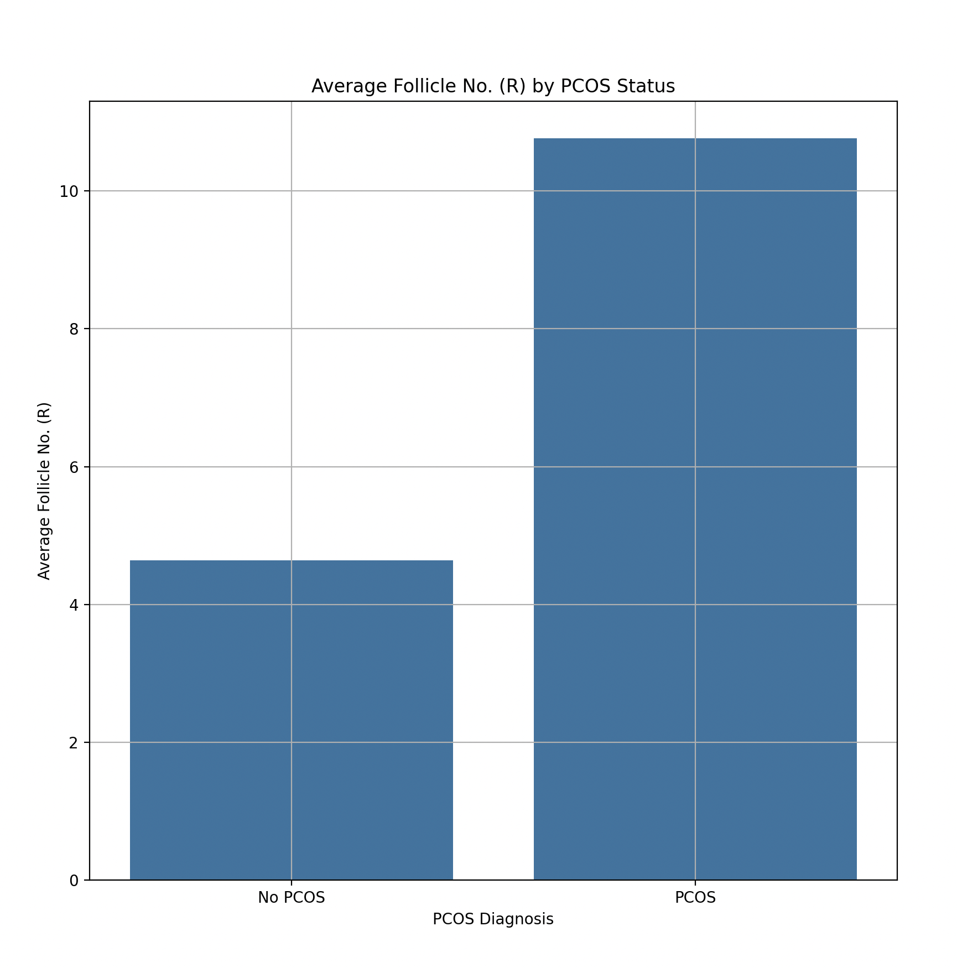
Notes:
This bar chart illustrates the average number of follicles on the right ovary, comparing individuals diagnosed with PCOS to those without the diagnosis. The data clearly shows a significant difference in follicle counts between the two groups. On average, individuals diagnosed with PCOS have about 11 follicles in the right ovary, whereas those without PCOS have around 5. This nearly double count in the PCOS group underscores the typical symptom of polycystic ovaries defined by an increased number of follicles.
In the context of PCOS, a higher number of follicles often correlates with hormonal imbalances and the ovaries' inability to regularly release eggs. This condition is a crucial diagnostic criterion in clinical settings.

Slide 11
More Dataset Features

Slide 12
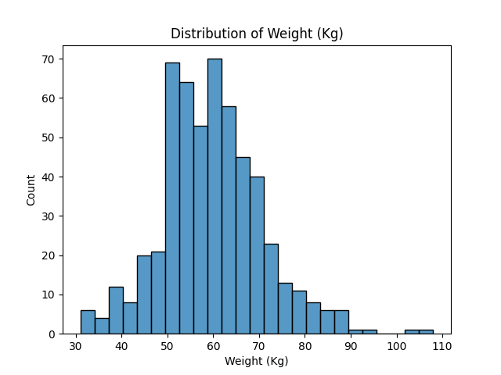
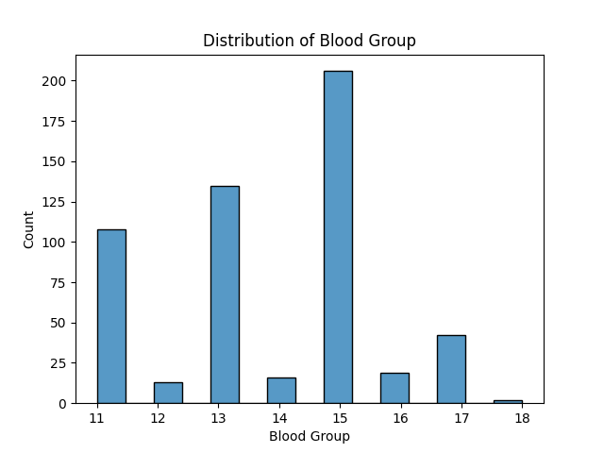
Distribution of numerical variables
mean std min max
Blood Group of the patient A+ = 11, A- = 12, B+ = 13, B- = 14, O+ =15, O- = 16, AB+ =17, AB- = 18

Slide 13
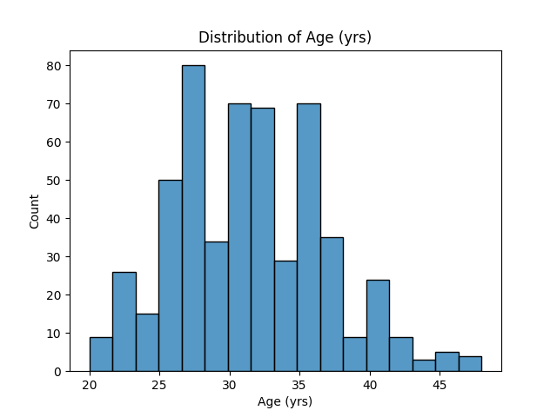
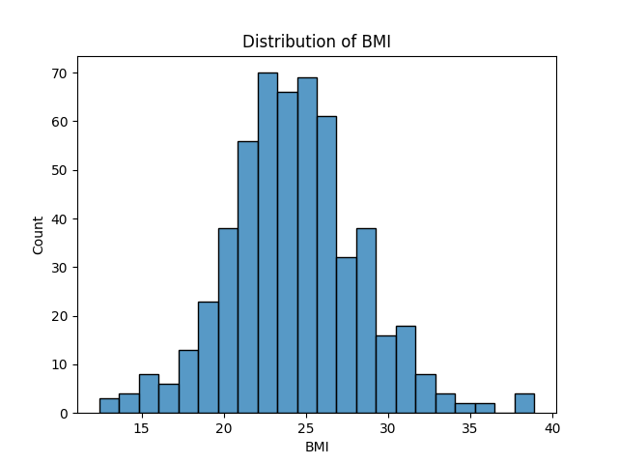
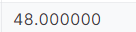
Distribution of numerical variables cont.
Count mean std min max
Count mean std min max

Slide 14
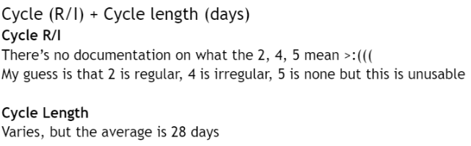
Contextualize Dataset Info
The average patient is/has:
156.48 lbs
31.43 years old
BMI of 24.311
Been married 5 years
More likely to be blood type (O+)
beta-HCG II (mlU/ML)
Used in fertility / pregnancy testing. Can also determine the age of the fetus based on gestation period.
FSH → Follicle-stimulating hormone
Levels vary based on puberty, menstruation, menopause
Waist/Hip ratio
Used with BMI to determine health risks
Health risk: obesity, type II diabetes, heart disease
Low = 0.80 or below
Moderate = 0.81 - 0.85
High = 0.86 or higher

Slide 15
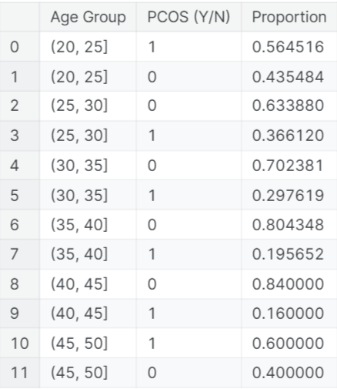
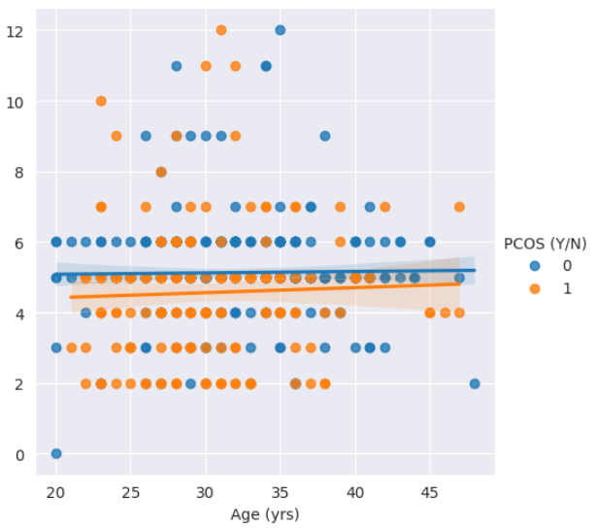
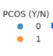
Proportion of diagnoses
Y axis:
Cycle length
→
Higher incidence rate in younger & older pop.

Slide 16
Initial Hypothesis
Age (yrs): Age can influence hormonal balance, which is crucial in PCOS.
Weight (Kg) and BMI: There's a known correlation between body weight, fat distribution, and PCOS.
Pulse rate (bpm): Although not a direct indicator, it might provide insights into metabolic rate and overall health.
Follicle Number (L/R) and Average Follicle Size: Directly related to ovarian function, which is central to PCOS diagnosis.
Endometrium (mm): Endometrial thickness can be affected by PCOS due to hormonal imbalances.
Fast food (Y/N): Diet and lifestyle choices are relevant to symptoms and management of PCOS.

Slide 17
Model Selection

Slide 18
Logistic Regression
The logistic regression model performed quite well in predicting PCOS based on the selected features:
Accuracy: 86.03%
Precision for Class 1 (PCOS): 78%
Recall for Class 1 (PCOS): 76%
F1-Score for Class 1 (PCOS): 77%
These results suggest that the model is quite effective, with good balance between precision and recall for detecting PCOS cases.
Notes:
We chose logistic regression because it is effective for cases where the outcome is binary, like diagnosing PCOS. It's also relatively simple and provides probabilities for each prediction, which are useful for clinical decision-making, as they offer a measure of how certain the model is about each diagnosis.

Slide 19
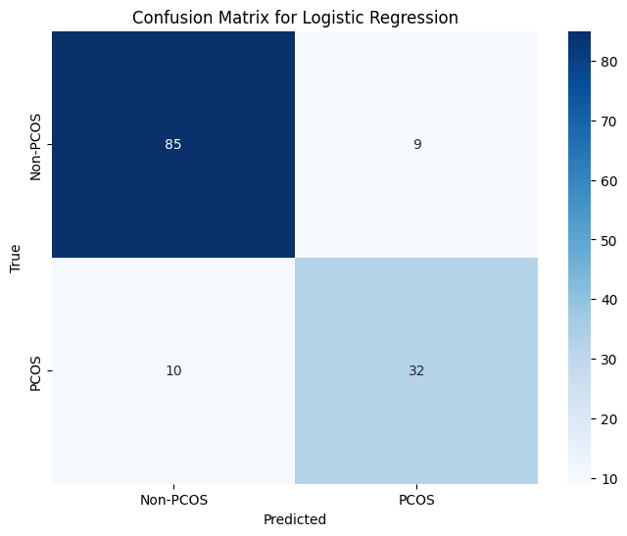
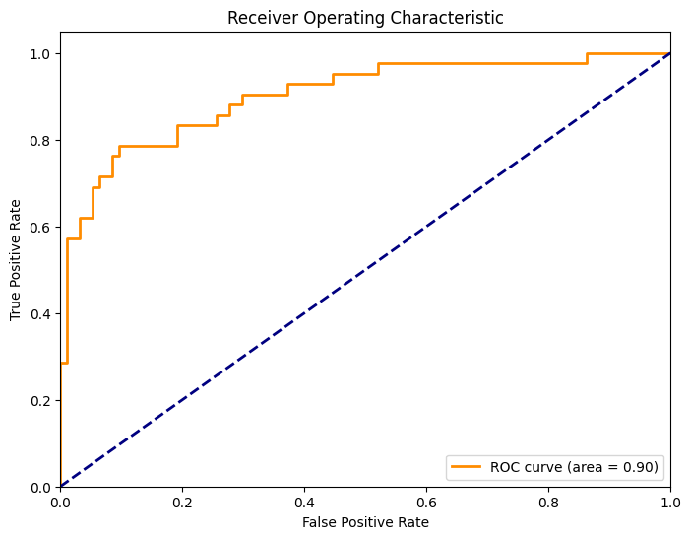
Notes:
Top-Left Square (True Negative): The number 85 represents the true negatives, which means that 85 times the model correctly predicted 'Non-PCOS'. Top-Right Square (False Positive): The number 9 indicates the false positives, which means that 9 times the model incorrectly predicted 'PCOS' when it was actually 'Non-PCOS'. Bottom-Left Square (False Negative): The number 10 represents the false negatives, indicating that 10 times the model incorrectly predicted 'Non-PCOS' when the truth was 'PCOS'. Bottom-Right Square (True Positive): The number 32 represents the true positives, meaning the model correctly predicted 'PCOS' 32 times. Interpreting the Confusion Matrix: Accuracy: The model's accuracy is given by the sum of the true positives and true negatives divided by the total number of predictions. In this case, (85 + 32) / (85 + 9 + 10 + 32). Precision for PCOS: The model's precision for predicting PCOS is the number of true positives divided by the total number of predicted positives (true positives + false positives). Here, it would be 32 / (32 + 9). Recall for PCOS: The model's recall for predicting PCOS is the number of true positives divided by the total number of actual positives (true positives + false negatives). Here, it would be 32 / (32 + 10).
This plot is a Receiver Operating Characteristic (ROC) curve, which is a graphical representation of the diagnostic ability of a binary classifier system as its discrimination threshold is varied.
The ROC curve plots the True Positive Rate (TPR) against the False Positive Rate (FPR) at various threshold settings. Here's what the terms mean:
True Positive Rate (Sensitivity): The proportion of actual positives that are correctly identified by the model. False Positive Rate (1 - Specificity): The proportion of actual negatives that are incorrectly identified by the model. The dotted blue line represents a classifier with no discriminative ability (random guessing), and it serves as a baseline; a good classifier stays as far away from this line as possible (towards the top-left corner).
Key points about the ROC curve you've uploaded:
Orange Line: Represents your model's performance at various thresholds. AUC (Area Under the Curve): The area under the ROC curve, mentioned as 0.90, indicates a very good level of separation between the positive and negative classes. AUC values range from 0 to 1, where: 0.5 signifies no discriminative ability (the same as random guessing), 0 to 0.5 signifies a model that is always wrong, 0.5 to 1 signifies levels from poor to excellent ability to discriminate between the positive and negative classes, 1 signifies a perfect model. Your model's ROC curve is close to the top-left corner, indicating a high true positive rate and a low false positive rate, which is excellent. The AUC of 0.90 suggests that the model has a 90% chance of correctly distinguishing between the patient having PCOS and not having PCOS.
This is generally considered an excellent model, but it's always important to balance the ROC curve insight with other metrics, especially in domains like healthcare where the costs of false positives and false negatives can be very different.

Slide 20
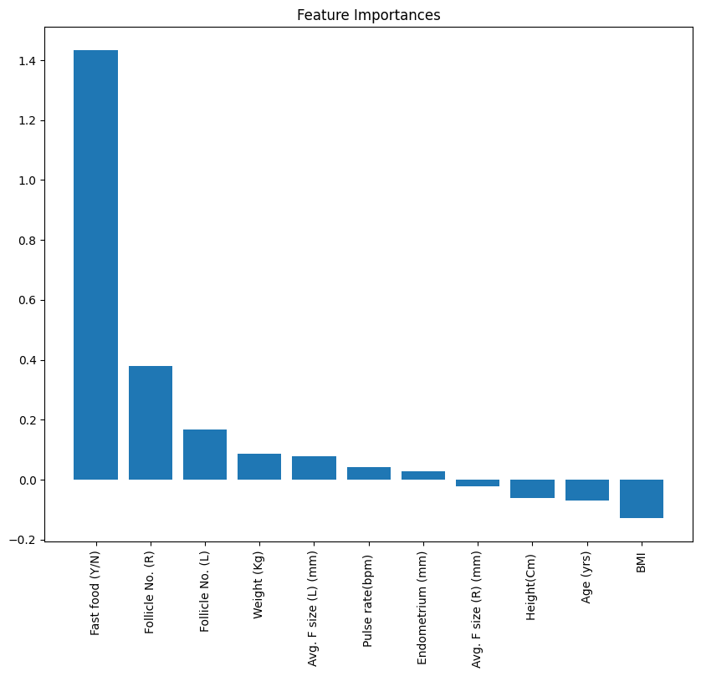
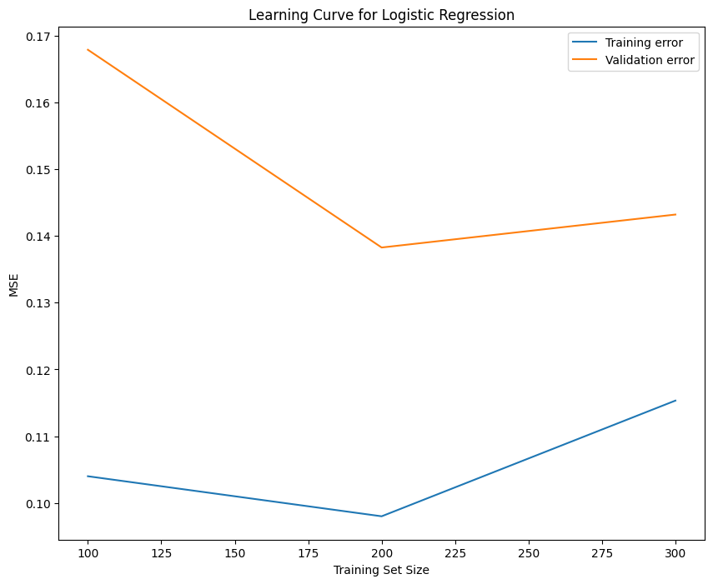

Slide 21
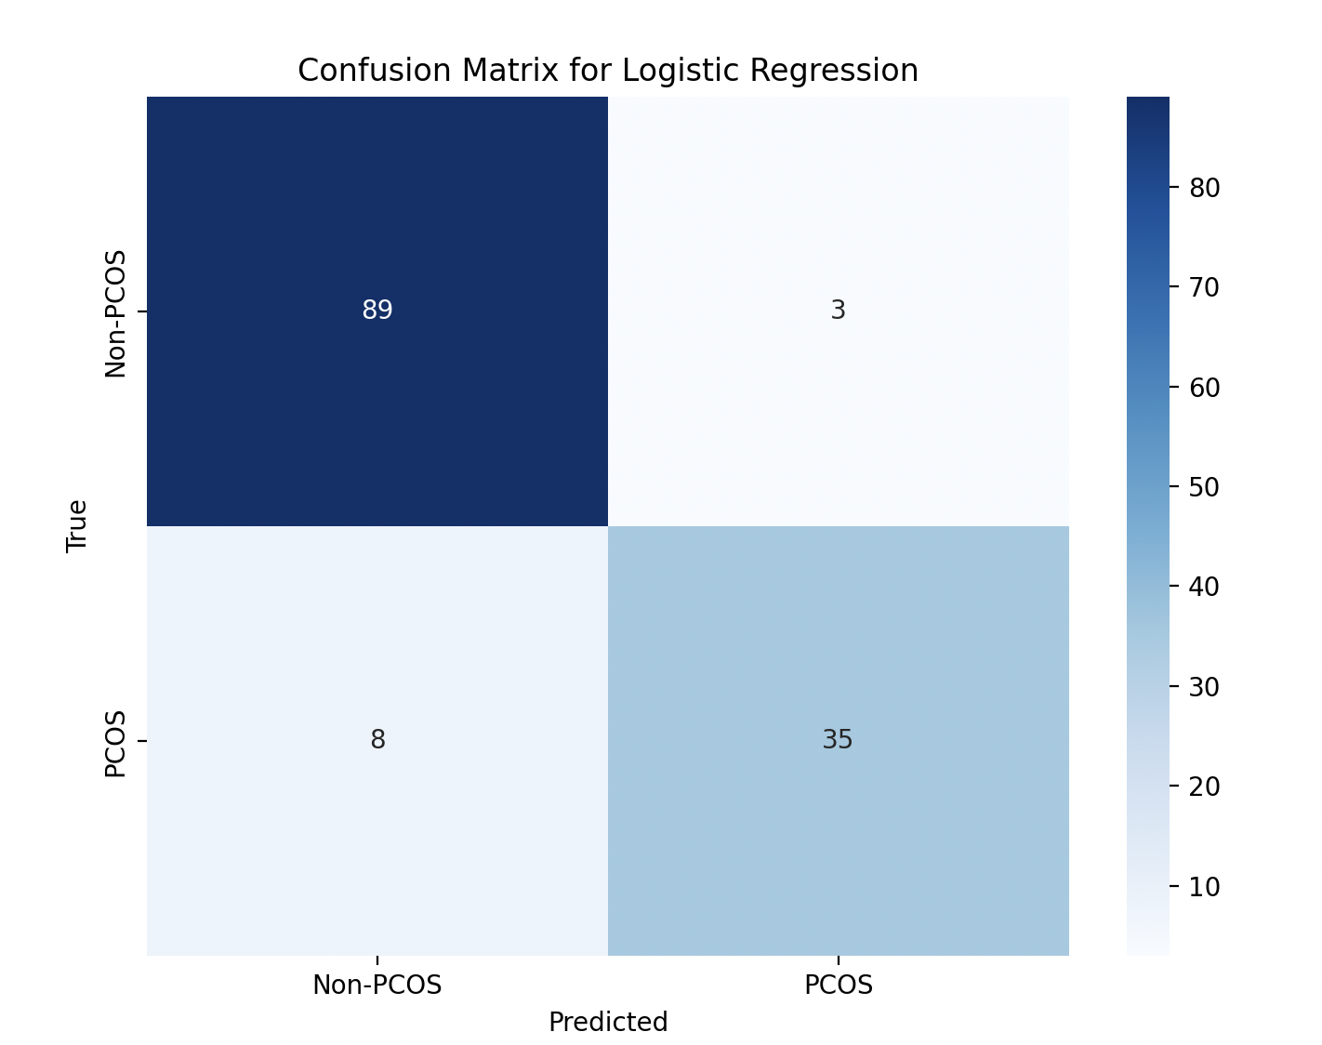
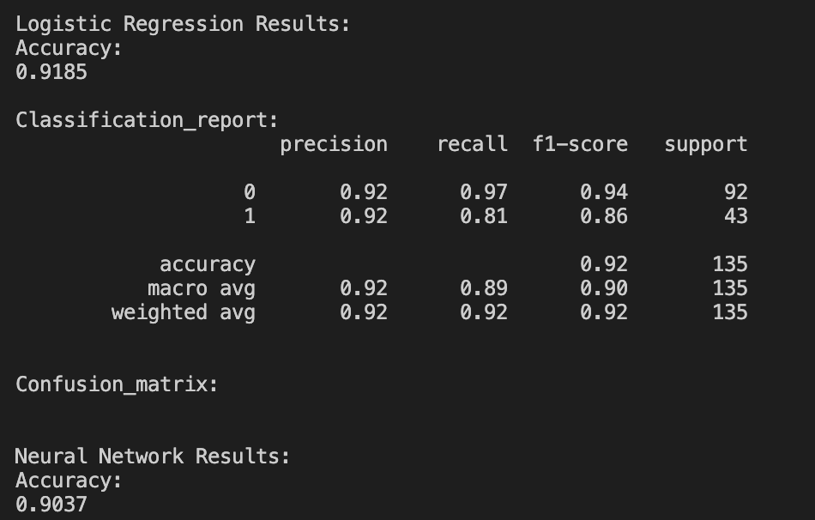
Notes:
test_size of .25
We applied two predictive models, Logistic Regression and a Neural Network, to predict the presence of PCOS based on various features with high correlation coefficients. Above absolute value .25.
We chose logistic regression because it is effective for cases where the outcome is binary, like diagnosing PCOS. It's also relatively simple and provides probabilities for each prediction, which are useful for clinical decision-making, as they offer a measure of how certain the model is about each diagnosis.
Data was standardized using StandardScaler to ensure features have mean zero and variance one, which helps improve the convergence of machine learning algorithms.
Scaling, or standardizing, the data helps to normalize the range of independent variables or features of data. In other words, it ensures that no single feature dominates others in training the model, which can happen if the features are measured in different scales. By scaling the features to a similar scale, we help improve the convergence of the algorithm, making training faster and more accurate. The features we chose are those most significantly correlated with PCOS, ensuring our models are focused and relevant.
Logistic regression is used to estimate the probability that a given input point belongs to a certain class. In this case, predicting whether an individual has PCOS or not based on their physiological data. The model outputs probabilities, and by using a threshold, typically 0.5, we classify each individual as having PCOS or not.

Slide 22
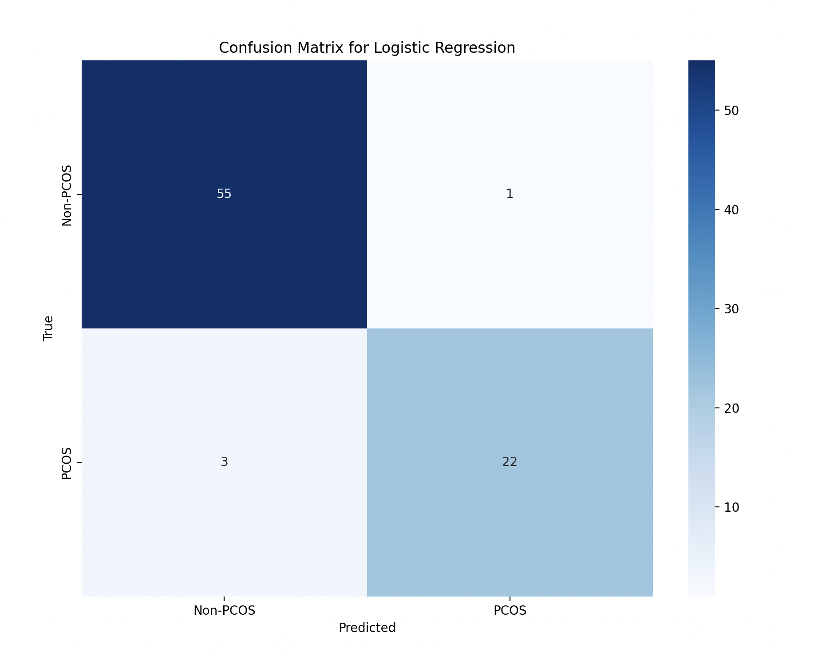
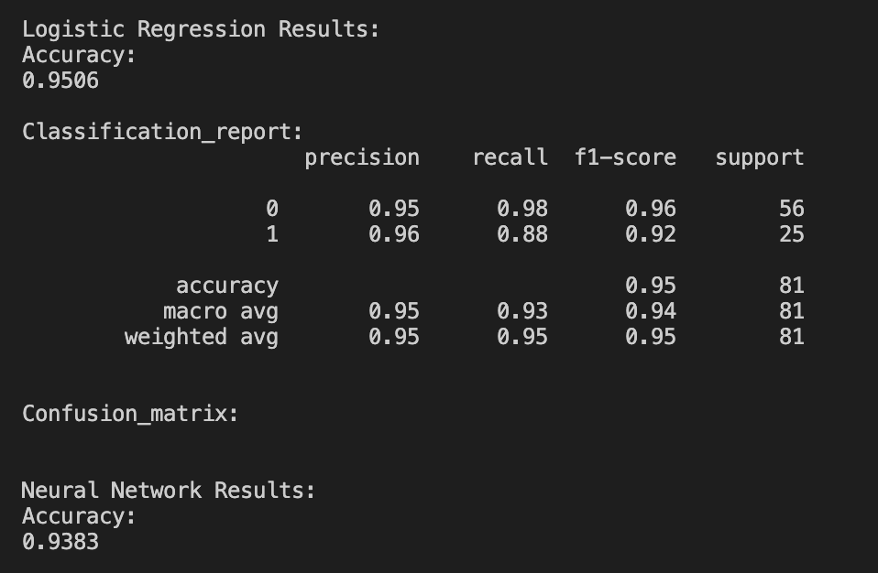
Notes:
Updated models using features selected from correlation matrix
Test_size = .15
Both models achieved an accuracy of above 90%, indicating high effectiveness in predicting PCOS status.
Logistic Regression Analysis Details
The model demonstrates higher precision and recall for non-PCOS cases, suggesting a strong ability to identify negative cases, with slightly lower sensitivity for positive cases.
our neural network model, this is a more complex approach that uses multiple layers of neurons with non-linear activation functions to capture complex patterns in the data. We include dropout layers in the architecture to reduce overfitting by randomly ignoring some neurons during training. This helps make our model robust and generalizable to new, unseen data.
Dropout layers are a technique used in building neural networks to prevent overfitting. Overfitting occurs when a model learns the detail and noise in the training data to the extent that it negatively impacts the performance of the model on new data. Dropout layers randomly 'drop out' a number of output features of the layer during training, meaning they are ignored during specific forward or backward passes. This helps make the model more robust and less likely to overfit on the noise in the training data.
Accuracy refers to the proportion of total predictions our model got right. For example, if our model correctly predicts whether 95 out of 100 patients have PCOS or not, then its accuracy is 95%. High accuracy means the model is generally reliable in its predictions.

Slide 23
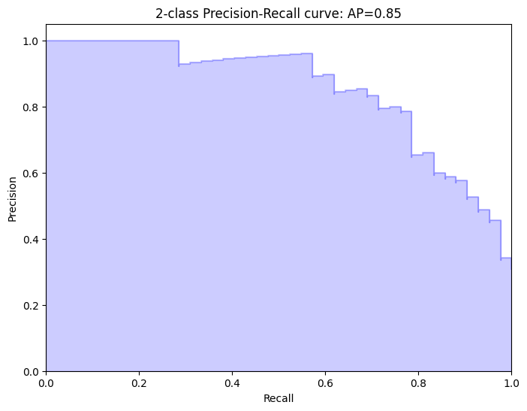
Notes:
Precision: It indicates the proportion of positive identifications that were actually correct. Precision is on the y-axis and a higher value is better. Recall (True Positive Rate): It shows the proportion of actual positives that were identified correctly. Recall is on the x-axis and a higher value is better. AP (Average Precision): This summarizes the precision-recall curve as the weighted mean of precisions achieved at each threshold, with the increase in recall from the previous threshold used as the weight. Here, the AP is 0.85, which indicates that the classifier has an average precision of 85% across all thresholds. A perfect classifier would have a PR curve that hugs the right angle, meaning it would have both precision and recall at 1.0. The closer the curve follows the top-right border of the plot, the more effective the classifier is.
The filled area represents the confidence or reliability of the curve. The more area filled, generally, the better the model is at returning high precision for a higher recall rate. Your model seems to have a fairly good balance of precision and recall since the average precision is quite high (0.85), indicating that it is effective in classifying the positive class accurately while also retrieving most of the positive instances.

Slide 24
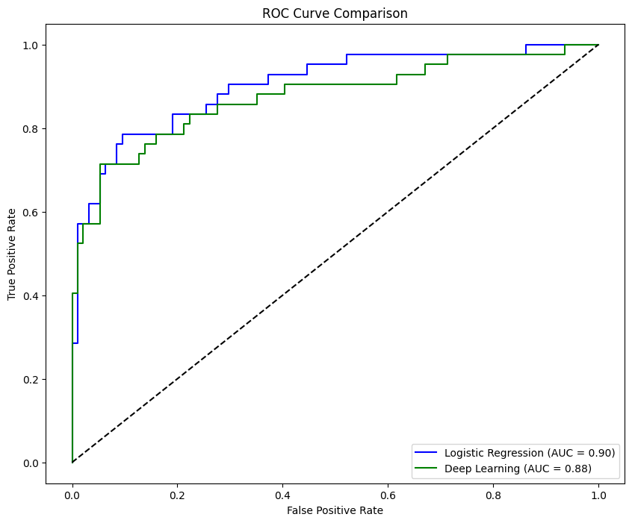
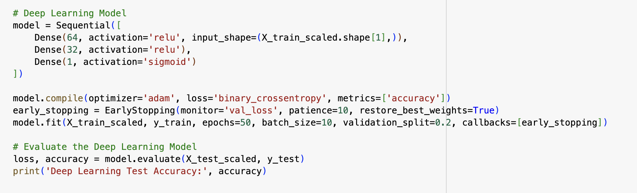
Deep Learning
Deep Learning Test Accuracy: 84.56%

Slide 25
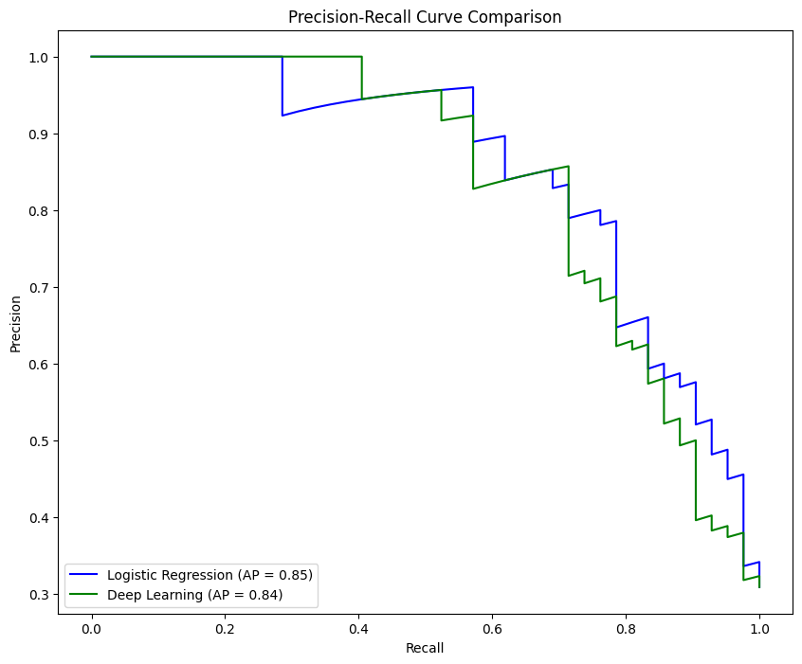
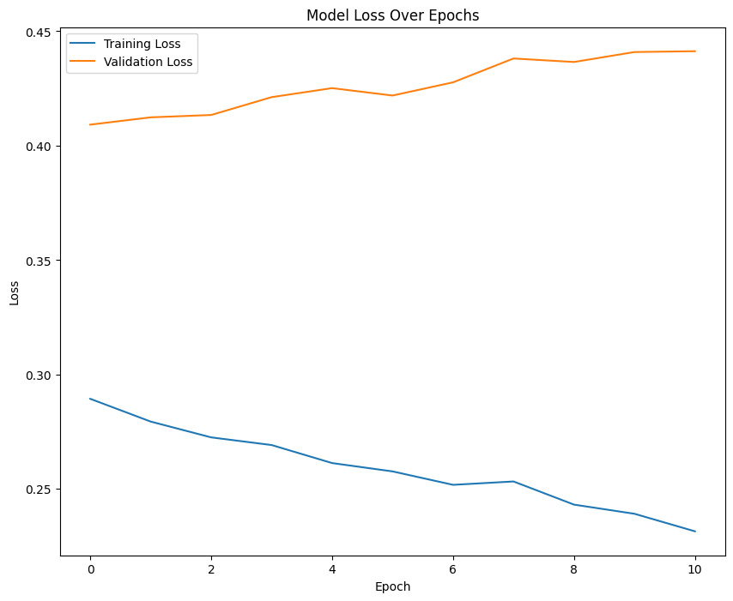
Notes:
Interpretation: Learning: The training loss is decreasing, which is a good sign that the model is learning from the training data. Generalization: However, the validation loss is increasing, which can be a sign of overfitting—meaning the model is learning patterns specific to the training data that do not generalize to the validation set. Action: If the validation loss continues to increase while the training loss decreases, you should consider implementing techniques to combat overfitting, such as adding dropout, regularization, collecting more data, reducing the model's complexity, or using early stopping to stop the training when the validation loss starts to increase. Epochs: The plot suggests that the model begins to overfit early in the training process (possibly even before epoch 1, based on the direction of the curves right from the start). Early stopping could be triggered to stop training early to prevent further overfitting. To improve the model, you might look into:
More robust validation techniques, such as cross-validation. Tweaking the model's architecture. Employing regularization techniques like L1/L2 regularization. Adjusting the learning rate. Using data augmentation techniques if applicable. When presenting this graph, you would discuss the above points, making clear that while the model is effectively learning the training data, it is not generalizing well to new data, as indicated by the rising validation loss.

Slide 26
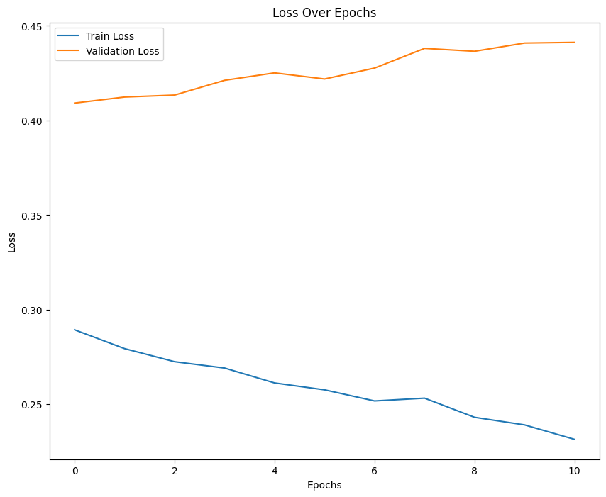
Notes:
Interpretation: Learning: The training loss is decreasing, which is a good sign that the model is learning from the training data. Generalization: However, the validation loss is increasing, which can be a sign of overfitting—meaning the model is learning patterns specific to the training data that do not generalize to the validation set. Action: If the validation loss continues to increase while the training loss decreases, you should consider implementing techniques to combat overfitting, such as adding dropout, regularization, collecting more data, reducing the model's complexity, or using early stopping to stop the training when the validation loss starts to increase. Epochs: The plot suggests that the model begins to overfit early in the training process (possibly even before epoch 1, based on the direction of the curves right from the start). Early stopping could be triggered to stop training early to prevent further overfitting. To improve the model, you might look into:
More robust validation techniques, such as cross-validation. Tweaking the model's architecture. Employing regularization techniques like L1/L2 regularization. Adjusting the learning rate. Using data augmentation techniques if applicable. When presenting this graph, you would discuss the above points, making clear that while the model is effectively learning the training data, it is not generalizing well to new data, as indicated by the rising validation loss.

Slide 27
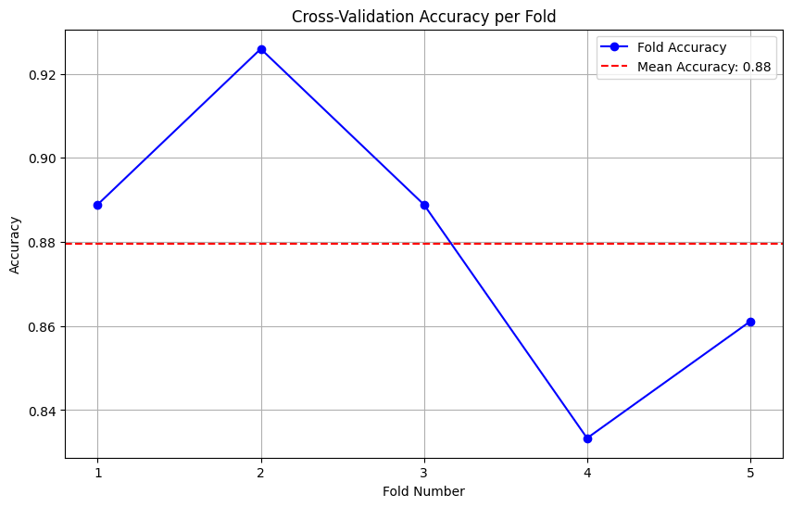
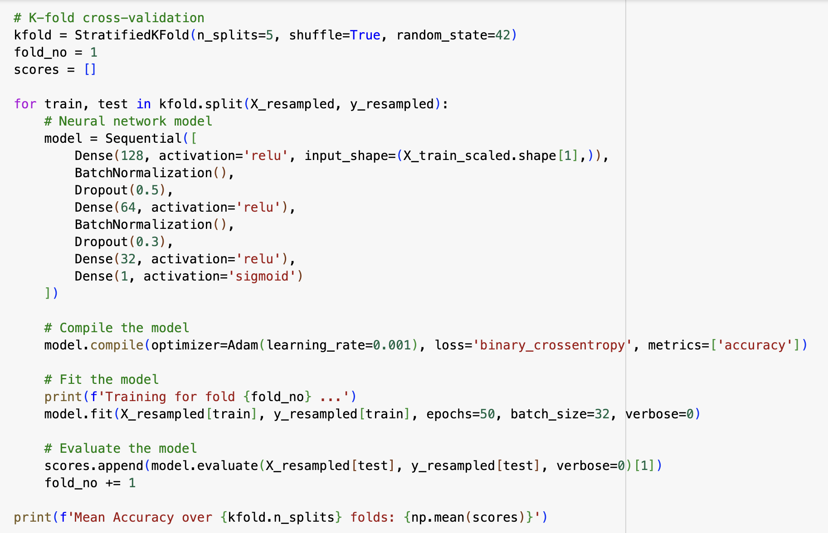
Deep learning with Cross Validation
Mean Accuracy over 5 folds: 0.879629623889923
Notes:
Model 3: Deep learning with Cross Validation K-Fold Cross-Validation: The dataset is divided into 'K' consecutive folds (usually of approximately equal size). Each fold acts as the test set exactly once, and acts as the training set 'K-1' times. The average performance metric score from the K iterations is used as the output of the model evaluation. This method is beneficial because it ensures that every observation from the original dataset has the chance to appear in both the training and test set. Stratified K-Fold Cross-Validation: Similar to K-Fold, but it is used for classification tasks and aims to ensure that each fold of the dataset has the same percentage of samples of each target class as the complete set. This method provides a more reliable estimate of the model's performance, especially when dealing with imbalanced datasets.
Cross-validation is a technique used to assess how well a model will generalize to an independent dataset, and it typically involves dividing the dataset into 'K' parts (folds), training the model 'K' times, each time using a different fold as the validation set and the remaining folds as the training set.
Here’s a breakdown of the graph:
Blue Dots (Fold Accuracy): Each dot represents the accuracy of the model on a different fold of the cross-validation. The x-axis indicates the fold number (1 through 5 in this case), and the y-axis represents the accuracy achieved on that fold. Red Dashed Line (Mean Accuracy): This horizontal line represents the average accuracy across all folds, which is labeled as 0.88 (or 88%). This line provides a baseline to see how each individual fold's accuracy compares to the overall average accuracy. Variation Across Folds: The graph shows variation in accuracy across different folds. The highest accuracy is achieved on fold 3, and the lowest on fold 5. Such variation can indicate differences in the difficulty of each fold, potential overfitting, or even the presence of outliers. Interpretation: Stability: The variation in accuracy across folds can indicate the stability of the model. In this graph, there is a noticeable dip in the last fold which could suggest that the model didn’t perform well on the data in that particular fold. Consistency: The average line provides a sense of the model's overall performance across all the cross-validation folds, smoothing out any anomalies in individual folds. Performance: The average accuracy gives an overall measure of the model's performance, which in this case is quite high at 88%. When presenting this in a deep learning context, it is important to discuss:
Why there might be variation across folds. The implications of the model's average performance. How this might inform further model development or deployment strategies. It's also important to note that accuracy is just one measure of model performance, and depending on the problem, other metrics such as precision, recall, F1 score, or ROC AUC might also be important to consider.

Slide 28
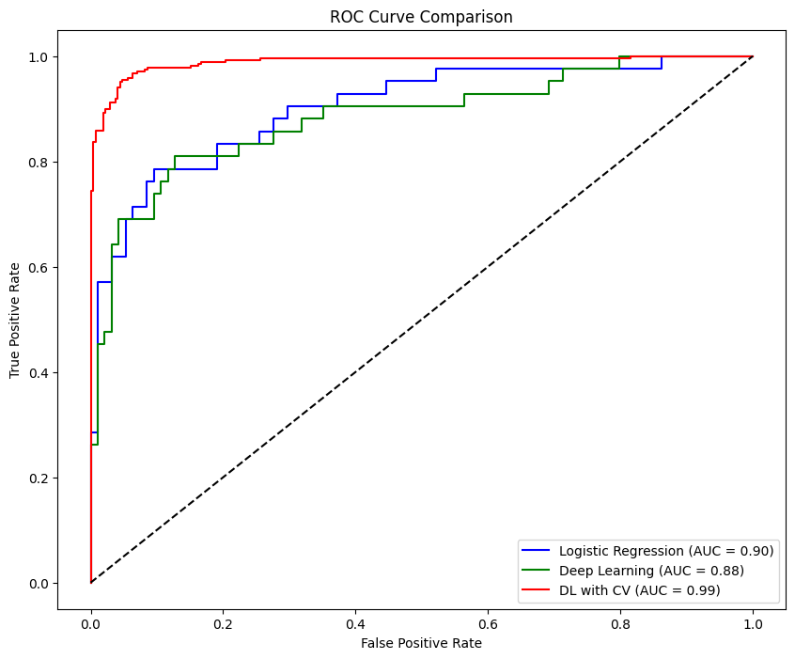
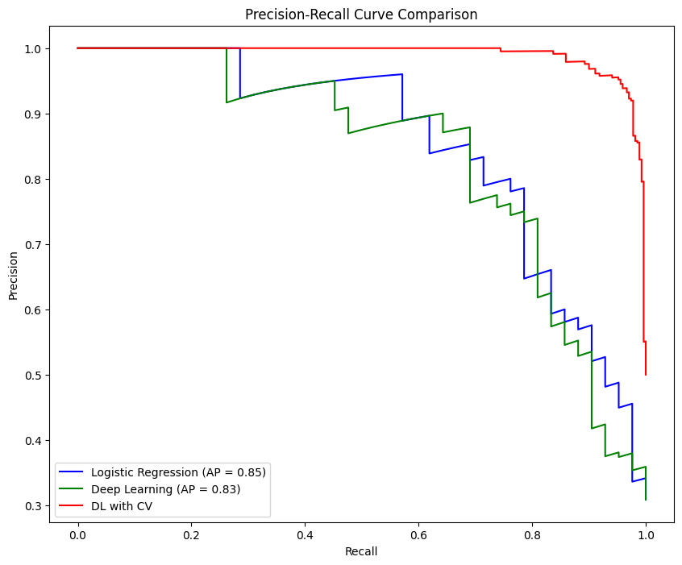
Notes:
ROC Curve: The ROC curve is a graphical representation of a classifier's performance. The curve plots the True Positive Rate (TPR) against the False Positive Rate (FPR) at various threshold settings. True Positive Rate (Y-axis): Also known as recall, it measures the proportion of actual positives that are correctly identified by the classifier. False Positive Rate (X-axis): Measures the proportion of actual negatives that are incorrectly identified as positive by the classifier. Diagonal Dashed Line: Represents the performance of a purely random classifier; a good classifier stays as far away from this line as possible (towards the top-left corner). Blue Curve (Logistic Regression): Shows the performance of the logistic regression model. The area under the curve (AUC) is 0.90, indicating very good classification performance. Red Curve (Deep Learning): Represents the deep learning model's performance, with an AUC of 0.88, which is slightly less than the logistic regression model but still indicates good performance. Green Curve (DL with CV): Shows the performance of the deep learning model with cross-validation, with an AUC of 0.98. This is close to the ideal score of 1.0, suggesting that the model is performing excellently and is likely well-generalized. Key Takeaways: Model Comparison: The DL with CV model outperforms the other two models with the highest AUC score. Generalization: The DL with CV model seems to generalize best to unseen data, as indicated by the highest AUC score. Performance: While all models perform well above random chance (which would be the diagonal line), the cross-validated model demonstrates the best capability of distinguishing between the classes. When presenting this plot, you should discuss how each model performs in terms of differentiating between the positive and negative classes. The high AUC for the DL with CV indicates a model that achieves both high true positive rates and low false positive rates across its operational range. It's also important to highlight the cross-validation process's impact on model performance, as it's likely to provide a more reliable estimate of the model's ability to generalize.
Precision-Recall Curve: This plot illustrates the trade-off between precision (y-axis) and recall (x-axis) for different probability thresholds. A high area under the curve represents both high recall and high precision, where high precision relates to a low false positive rate, and high recall relates to a low false negative rate. Precision (y-axis): Shows the ratio of true positives to the sum of true positives and false positives. High precision indicates a lower rate of false positives. Recall (x-axis): Shows the ratio of true positives to the sum of true positives and false negatives. High recall indicates a lower rate of false negatives. Curves: Blue Line (Logistic Regression): Represents the performance of the Logistic Regression model. Red Line (Deep Learning): Represents the performance of the standard Deep Learning model. Green Line (DL with CV): Represents the performance of the Deep Learning model trained with Cross-Validation. Interpretation of the Plot: Model Comparison: Comparing the curves, you can see which model achieves the best balance between precision and recall. The ideal model would have a curve that stays towards the top right corner of the plot. Logistic Regression (Blue): This curve seems to have the highest precision for a given recall rate compared to other models. Deep Learning (Red): This curve starts off well but quickly drops, suggesting that while it can achieve high precision, it's only within a limited range of recall. After a certain point, as you try to capture more positive cases (increase recall), the precision drops significantly. Deep Learning with CV (Green): This model's curve suggests that its performance is similar to the standard deep learning model but might be more stable across different thresholds, indicated by less fluctuation. Considerations: Steepness of the Curve: A steeper curve suggests that precision can be maintained to a higher recall level, which is generally better. Thresholds: Each point on the curve represents a different threshold of classification. You might need to pick a threshold that balances precision and recall in a way that is suitable for your application. Model Selection: If your application prioritizes precision (i.e., it is more costly to have false positives), you might prefer a model with higher precision at the relevant recall level. If it prioritizes recall (i.e., it is more costly to have false negatives), you might prefer a model with higher recall. Area Under Curve (AUC): While not explicitly shown here, you would ideally calculate the area under each precision-recall curve to quantify the overall performance of the models. This Precision-Recall Curve is particularly useful when dealing with imbalanced datasets, where the number of positive samples is much smaller than the number of negatives. It provides a more informative picture of a model’s performance than ROC curves in such cases.

Slide 29
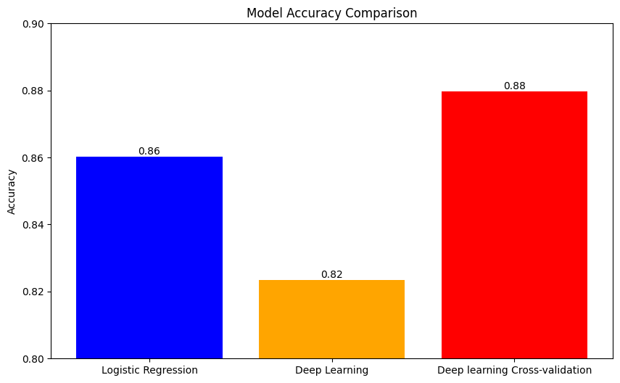
Model Comparisons

Slide 30
Results & Discussion
The logistic regression model achieved an accuracy of 94%, with precision and recall at 96% and 93%, respectively. Feature importance analysis revealed that ‘Fast Food’, 'Follicle No. (R)', ‘Weight’ and 'Avg. F size (L) (mm)' were pivotal in predicting PCOS.
Our deep learning model, particularly when enhanced with cross-validation, achieved an impressive accuracy of 88%, indicating robust generalizability.

Slide 31
Model Performance
High Accuracy Factors:
Advanced Capability: Deep learning ability to capture non-linear relationships in data likely enhanced its performance.
Cross-Validation: Rigorous cross-validation contributed to robustness, ensuring the model performs well on unseen data.
Preprocessing and Feature Selection: Careful preprocessing and strategic feature selection based on domain expertise helped focus the model on the most relevant predictors, reducing noise.
Notes:
The high accuracy rate of the deep learning model may be attributed to several factors. Firstly, the advanced capability of deep learning to capture non-linear relationships in data, coupled with rigorous cross-validation, likely contributed to its robust performance. Secondly, the careful preprocessing and selection of features based on domain expertise helped minimize noise and focus learning on relevant predictors. However, we must consider the potential of overfitting, as deep learning models are particularly prone to memorize rather than generalize from the training data. Future studies could explore the incorporation of dropout techniques and regularization to mitigate this risk. Furthermore, deploying these models in a clinical setting would require validation on an independent external dataset to truly assess their practical utility.

Slide 32
Future Improvements
Considerations and Cautions:
Risk of Overfitting: Deep learning models are prone to memorizing training data rather than generalizing from it, raising concerns about overfitting.
Future Improvements:
Dropout Techniques: Incorporating dropout techniques and regularization could help mitigate overfitting risks.
External Validation: For clinical deployment, validating models on an independent external dataset is crucial to confirm their practical utility and reliability.

Slide 33
Exploration of data
relevant physical and clinical parameters for PCOS

Slide 34
DEMO (?)
1: Project presentation lacked any sort of depth and clarity, student(s) presenting did not clearly address issues from prompt
2: Project presentation included little detail and inconclusive results, difficult to understand
3: Project presentation addresses challenges stated in prompt clearly and concisely, easy for audience to follow and understand

Slide 35
PROJECT DESIGN
1: Project not designed well; yields no tangible results or applicability
2: Project designed to move forward, but disjointed approach
3: Project designed to move forward in systematic way
This is what the syllabus says:
https://docs.google.com/document/d/1mIJUfQBfq0tC8_9HiACewh-5BFG6YwUM-XBBFJKJt0k/edit

Slide 36
Coordination

Slide 37
Exploration of data

Slide 38
ADDRESSING STATED PROBLEMS
1: Results did not address stated problem at all
2: Results include missing details and inconclusive results
3: Results solves stated problem at face value

Slide 39
Fixing outliers
<decision point, challenges>

Slide 40
Choosing the models

